Slide 1
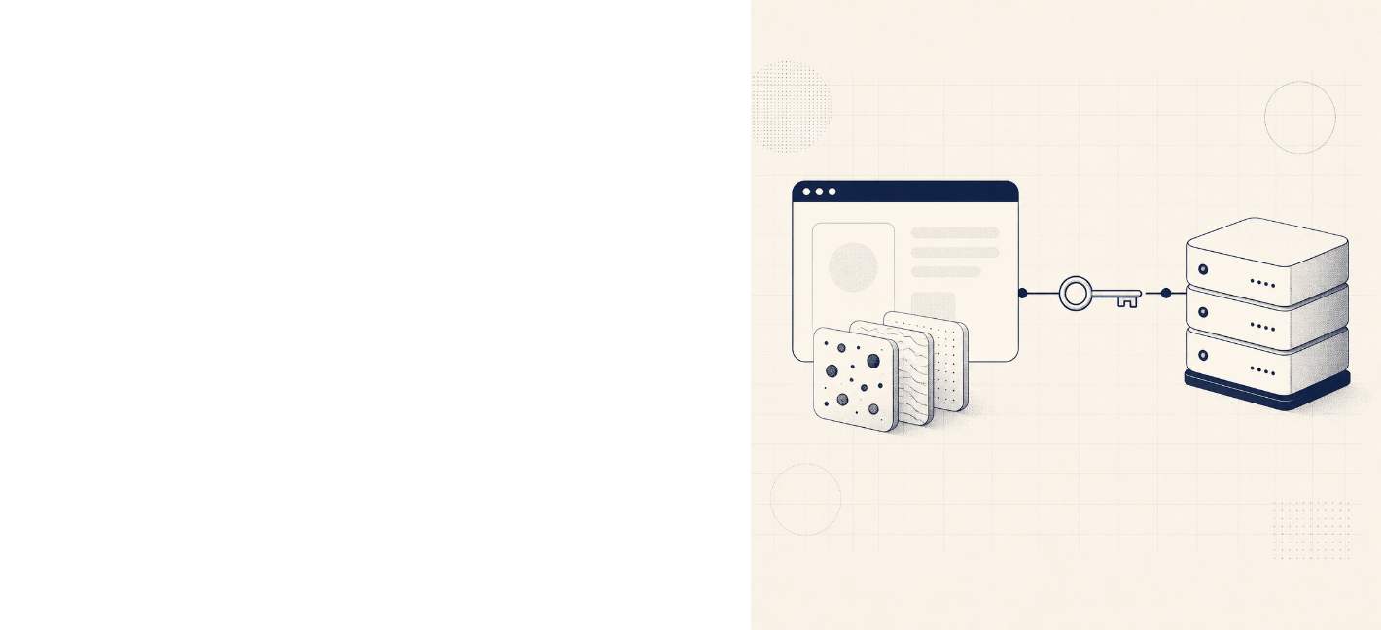
web fundamentals
Cookies vs Sessions
Guided By: Dr. D. Sudhagar
CSA4305 Internet Programming
Ebin Antony P
192373011
B.E. CSE(DS)

Slide 2


Two mechanisms, one goal
web fundamentals
Both mechanisms help an application
recognize a browser across requests. The
decisive difference is where the meaningful
state lives.
THE DESIGN QUESTION
Where should the
application trust the state?
01
Cookies
Cookies keep state close to the
client. Sessions keep authority close
to the server.
Small key-value data stored in
the user's browser
02
Sessions
Server-side state identified by a
session ID
Foundations / Cookies vs Sessions
02

Slide 3



Storage location changes the trade-off
web fundamentals
CLIENT-SIDE
SERVER-SIDE
Cookies
Sessions
Sent with matching requests;
limited size and client-controlled
Data stays on the server; the
browser typically holds only an
opaque ID
Simple for preferences and lightweight
state
Stronger for carts, accounts, and sensitive
workflows
Storage model / Cookies vs Sessions
03

Slide 4


Security and performance are connected
web fundamentals
RISK SURFACE
RUNTIME COST
Cookies: protect with Secure, HttpOnly, and
SameSite attributes
Cookie payloads travel on requests;
large cookies add bandwidth
overhead
01
Session risks: stolen IDs, fixation, weak
expiration, and server-store exposure
02
Sessions add lookup and storage
cost, but keep sensitive data off the
client
Neither is automatically secure: HTTPS,
rotation, expiration, and CSRF defenses
matter
The best choice is a threat-model decision with a
measurable runtime budget.
Risk + runtime / Cookies vs Sessions
04

Slide 5


web fundamentals
Decision guide / 2026
Choose by use case, not
habit
01
Remember theme or language: cookie
Keep a signed-in user recognized:
session ID in a cookie
02
03
Shopping cart across devices:
server-backed session or account data
04
High-scale stateless APIs: short-lived
signed token cookie or Authorization
token
05
Real-time dashboards: session-backed
authentication plus WebSocket
connection checks
Bottom line: minimize client-held data;
keep authority server-side
06
Cookies vs Sessions / Critical analysis for web applications

